Slide 1

JDBC and Hibernate
Xincheng Yang

Slide 2
Outline
JDBC & ODBC
Introduction
Architecture
Grammar
Execution
Introduction
Grammar
Hibernate Advanced
Auto DDL and Reverse engineering
HQL
Connection Pool
Reflection (Java advanced)
Annotation (Java advanced)
1
3
2
Hibernate
Introduction
Architecture
Grammar
Data mapping
4
Simple Hibernate Implementation
Configuration
SessionFactory
Session
Annotations
Data mapping

Slide 3
JDBC

Slide 4
Why JDBC?
Suppose we build a project with a database.
Now we have Java or Python programs.
Q: How to access database using programming language?
Answer: JDBC or ODBC
ODBC (Open DataBase Connectivity）is design for C, C++, C# and VB.
JDBC (Java DataBase Connectivity) is design for Java.
For different version of database, we have different version of JDBC driver to match it.

Slide 5
JDBC Introduction
JDBC is a Java API for communicating with database systems supporting SQL.
JDBC supports a variety of features for querying and updating data, and for retrieving query results.
JDBC also supports metadata retrieval, such as querying about relations present in the database and the names and types of relation attributes.
Model for communicating with the database:
Open a connection
Create a “statement” object
Execute queries using the Statement object to send queries and fetch results
Exception mechanism to handle errors

Slide 6
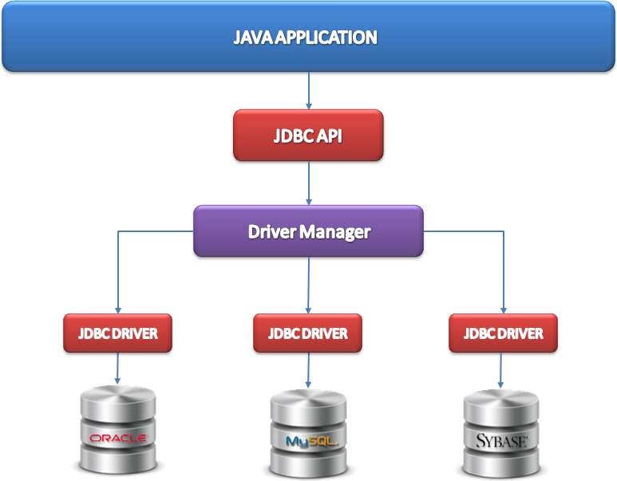
JDBC Architecture
01
JDBC consists of two parts:
JDBC API, a purely Java-based API
JDBC Driver Manager ,which communicates with vendor-specific drivers that perform the real communication with the database.

Slide 7
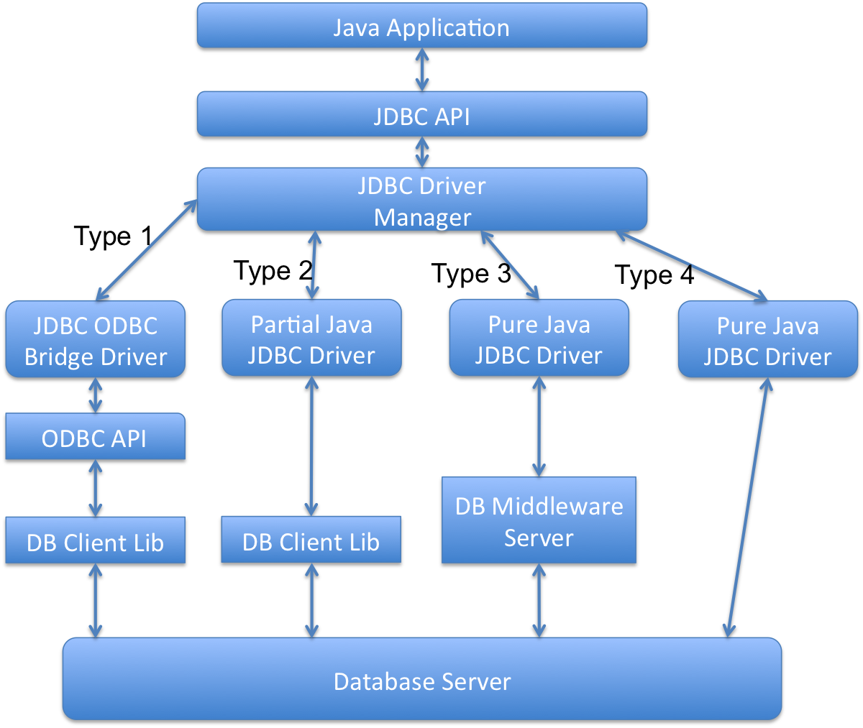
JDBC Architecture
02
JDBC internal:
Different vendor-specified driver have different connect stratigies for database server .

Slide 8
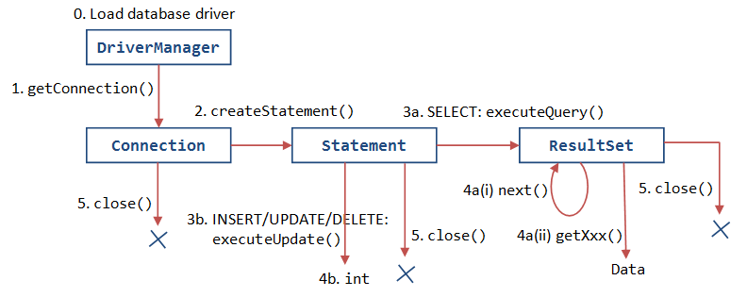
7 Steps in using JDBC
1. Load the driver
2. Define the Connection URL
3. Establish the Connection
4. Create a Statement object
5. Execute a query
6. Process the results
7. Close the connection

Slide 9
Step 0. Import external jar
To use a JDBC driver, we must download and import the related library(jar file) from driver provider.
Demo

Slide 10
Step 1. Load the driver
To use a JDBC driver, we must first register it in the JDBC DriverManager.
This is usually done by loading the driver class using the forName method of the class called Class.
try {
Class.forName("com.mysql.jdbc.Driver"); // Load mysql driver
Class.forName("oracle.jdbc.driver.OracleDriver"); //Load oracle driver,
} catch (ClassNotFoundException cnfe) {
System.out.println("Error loading driver: " + cnfe);
}

Slide 11
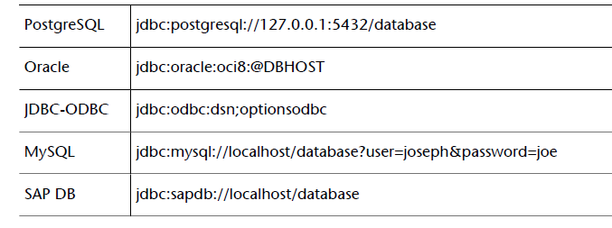
Step 2. Define the connetion URL
To identify a given connection to a database, DBMS use a URL (Universal Resource Locator) address format. This address usually takes the form:
jdbc:driver:database

Slide 12
Step 3. Establish connection and statement
To establish a connection, you must provide the username and password to access the database.
You can either provide the required information in connection URL or method parameters .
String url = “jdbc:mysql://127.0.0.1:3306/testdb?user=root&password=pwd”
Connection conn = DriverMagager.getConnection(url);
String url = “jdbc:oracle:thin:@localhost:1521:orcl”
Connection conn = DriverMagager.getConnection(url, "root", "pwd");

Slide 13
Step 4. Create Statement
You can create statement or preparedstatement .
For prepared statement, you can set parameters.
Statement stmt= conn.createStatement();
String sql = “SELECT id FROM Student WHERE id=? AND name=?”;
Statement pstmt= conn.prepareStatement(sql);
pstmt.setInt(1, 123); // 1 will replace the first ‘?’ with 123.
pstmt.setString(2, “Omar”); // 2 will replace the second ‘?’ with ‘Omar’

Slide 14
Step 5. Execute query
You can execute query base on statement or preparedstatement .
For create table/drop table/insert/update, you can use execute() or executeUpdate().
For query data, you need use executeQuery().
String sql = “SELECT * FROM Student”;
ResultSet rs = stmt.executeQuery(sql);
String sql = “DELETE FROM Student WHERE id=?”;
Statement pstmt= conn.prepareStatement(sql);
pstmt.setInt(1, 123); // 1 will replace the first ‘?’ with 123.
pstmt.executeUpdate();

Slide 15
Step 6. ResultSet
ResultSet is a set for query results.
Get data based on type: getString(param), getInt(param), getDate(param)....
Get data based on column index or column name：getType(1), getType(“StudentID”)
Combine datatype and column parameter:
String sql = “SELECT * FROM Student”;
ResultSet rs = stmt.executeQuery(sql);
while(rs.next()) {
Int id = rs.getInt(1);
String name = rs.getString(“name”);
System.out.println(“id=” + id + “, name=” + name);
}

Slide 16
Step 6. ResultSet
For ResultSet rs.
Get rows
Get MetaData
Columns
ColumnName & ColumnType
Code:
int row = rs.getRow();
ResultSetMetaData meta = rs.getMetaData();
For(int i = 0; i < meta.getColumnCount(); i++) {
System.out.println(meta.getColumnName(i));
System.out.println(meta.getColumnTypeName(i));
}

Slide 17
Step 7. Close connection
Don’t forget close connection!
Connection conn = null;
…
/* Execute sql commands with jdbc */
...
conn.close();

Slide 18
JDBC Demo
Demo

Slide 19
Hibernate

Slide 20
Why Hibernate?
Suppose we build a project with a database.
Now we have Java objects(E.g., Student).
Q: How to map the entities in database to Java objects?
1
Answer: 1. Manually add data column by column based on JDBC
2. Hibernate map automatically(Data-Mapping)
2
Suppose we have 100 java objects in a project. (E.g., Student, Teacher, TA …)
We need manipulate each java object by our program with JDBC. For each object we need write Insert/Update/Delete functions.(For simply this problem, we do not consider Query)
Q: How many SQL commands do we need for our program?
Answer with JDBC: 100 * 3 = 300.
Answer with Hibernate: 0 (Data-Mapping)

Slide 21
Why Hibernate?
3
Suppose we build a project with a database, with 100 tables and 100 java objects.
Q: Do we need to write program for both side? (100 for create table, 100 for write java object)
JDBC: We need Both create tables and Java objects.
Hibernate: We need Either tables or Java objects(Auto-DDL or Reverse-Engineering).
(Different database have its specified grammar)Suppose we already have a project, which is build based on Oracle database and we use Oracle JDBC.
In our program, we automatically increase the student id by Oracle database(sequence mechanism).
Now we plan to move data to MySQL database, because we do not have funding for this project and we can not afford Oracle database.
Q: How many lines of code do we need to modify in our program for this data migration?
4
JDBC: We do not know. Hibernate:0 lines of code(Factory design pattern)

Slide 22
Hibernate Mapping
Assume we have:
Database: Enroll(enrollId, studentId, courseId), Student(studentId, name), Course(courseId, name)
Java: Enroll(eid, List<Student>, Course), Student(id, name), Course(id, name)
Hibernate provides
Entities, foreign key relationship in database <--mapping to --> Java Object, which is configurable.
XML mapping strategy
Annotation mapping strategy

Slide 23
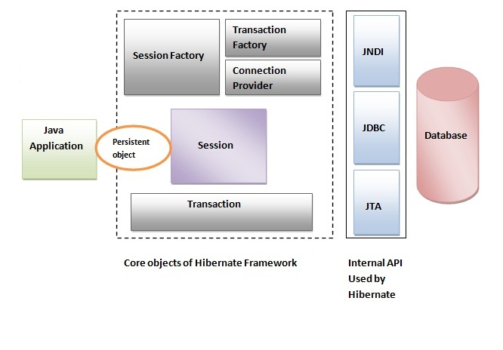
Hibernate Architecture
01
Hibernate consists of two parts:
Core objects for hibernate framework
Session, SessionFactory etc.
Internal API used by hibernate.
JDBC
JNDI(Java Naming and Directory Interface)
JTA(Java Transaction Api)

Slide 24
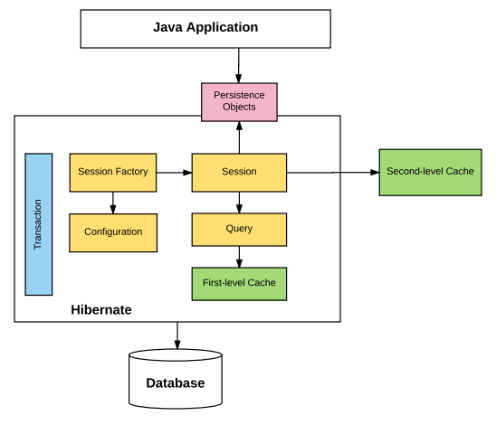
6 Steps in using Hibernate
1. Load the configuration file
2. Create SessionFactory
3. Get Session from SessionFactory
4. Access database:
4.1 Update or save an object
4.2 Execute a HQL/SQL query
5. Get the results
6. Close the Session

Slide 25
Step 0. Install Hibernate
To use Hibernate, we must Install hibernate by download or install from the internet .
No demo here, you can follow the turtorial from google.
Option 1. Download essential libarary(Hibernate.jar) only.
Manually download from google and install.
Maven, gradle, ant etc.
Option 2. Download Jboss tools in eclipse marketplace(Jboss tools contains hibernate tools, which includes reverse engineering etc.):
https://marketplace.eclipse.org/content/jboss-tools

Slide 26
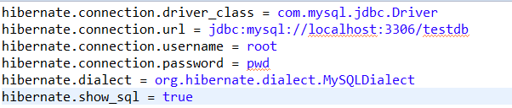
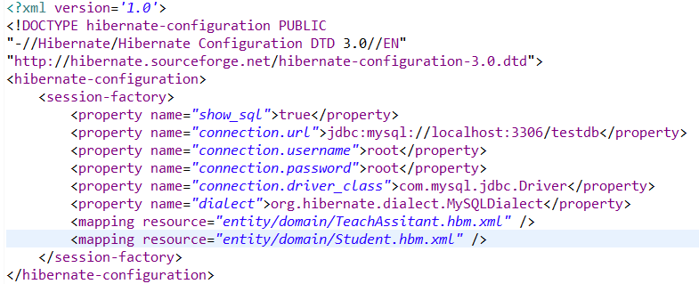
Step 1. Configuration
To access database, we must load a configuration file.
A configuration file can be
.properties format
XML format
Code to load configuration:
Import org.hibernate.cfg.Configuration;
Configuration cfg = new Configuration().configure(“FILE PATH”);

Slide 27
Step 2&3. Create SessionFactory and Get Session
To use SessionFactory, we must have a configuration file.
This is usually done by loading the driver class using the forName method of the class called Class.
1.
Configuration cfg = new Configuration().configure(“FILE PATH”);
SessionFactory sf = cfg.buildSessionFactory();
Session session = .openSession();
2.
SessionFactory sf = new Configuration().configure().buildSessionFactory();
Session session = sf.openSession();
Not recommend(When close(), we may have connection pool release problem)
Session session = new Configuration().configure(“PATH”).buildSessionFactory().openSession();

Slide 28
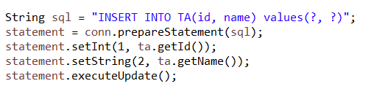
Step 4.1 & 5 Insert/Update/Delete
Assume we have TeachAssitant object.
Fields
id
name
TeachAssitant ta = new TeachAssitant(1, “mike”);
Insert/update this object:
session.save(ta); // Return primary key
Delete this object:
session.delete(ta); // Return # records deleted
Compare to JDBC:
...Update..Delete...

Slide 29
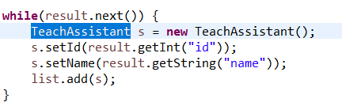
Step 4.2 & 5 Query
Hibernate provide 3 strategies to execute query.
Query: using HQL language
SQLQuery: using SQL language
Criteria<Skip>: get object directly
Query by sql:
String sql = “SELECT * FROM TA”;
SQLQuery query = session.createSQLQuery(sql).addEntity(TeachAsistant.class);
List<TeachAsistant> ta = query.list(); //Return a list of results.
TeachAsistant ta = query.uniqueResult(); //Return the first result.
Compare to JDBC:

Slide 30
Step 6. Close session and session factory
Don’t forget close session and session factory! Note the order when you close them.
SessionFactory factory = ...
Session session = factory.openSession();
…
/* Execute sql commands with jdbc */
...
session.close(); //Session should be close first
factory.close();

Slide 31
Hibernate Mapping
Assume we have:
Database: Enroll(enrollId, studentId, courseId), Student(studentId, name), Course(courseId, name)
Java: Enroll(eid, List<Student>, Course), Student(id, name), Course(id, name)
Hibernate provides
Entities, foreign key relationship in database <--mapping to --> Java Object, which is configurable.
XML mapping strategy
Annotation mapping strategy
Q: How does hibernate know a column ‘studentId’ in database should mapping to the field ‘id ’ of Student object?

Slide 32
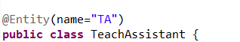
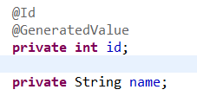
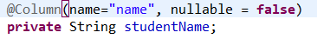
Data Mapping
(Java Object)
Hibernate provides 2 mapping strategies:
XML (Skip)
Annotation
@Entity : Java class
@Id : Primary key
@GeneratedValue : Automatically increate
@Column: A column in database
Foreign keys:
@ManyToMany
@OneToOne
@ManyToOne
@OneToMany

Slide 33
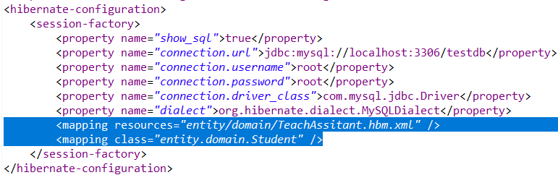
Data Mapping(Configuration file)
We need to add the 2 mapping strategies in to configuration file:
Hibernate recommend we use XML configuration file(So I skip “.properties” version)
For Annotation object:
<mapping class="entity.domain.Student"/>
For XML object:
<mapping resources="entity/domain/TeachAsistant.hbm.xml"/>

Slide 34
Concepts
ORM: Object-Relational Mapping
JPA: Java Persistence API
Higher level standard of ORM in Java.
Hibernate: a Java implementation for JPA.

Slide 35
Hibernate Demo
Demo

Slide 36
Hibernate Advanced

Slide 37
Auto DDL
We can use Hibernate auto-ddl to automatically create tables based on our Java objects.
Set auto ddl in configuration file
Possible values
none: not activate auto ddl.
create: creates the schema necessary for your entities, destroying any previous data.
update: update the schema to reflect the entities being persisted
valid: validate that the schema matches
create-drop: create the schema as in create above, but also drop the schema at the end of the session.

Slide 38
Reverse Engineering
Reverse engineering allows you generate Java objects automatically based on entities in database.
(You need hibernate tools to do reverse engineering)
In eclipse：
Step 1. Download JBoss tools in eclipse
https://marketplace.eclipse.org/content/jboss-tools
Other steps:
https://www.javacodegeeks.com/2013/10/step-by-step-auto-code-generation-for-pojo-domain-java-classes-and-hbm-using-eclipse-hibernate-plugin.html.

Slide 39
HQL
Hibernate support hibernate specified query language (HQL).
HQL is Java object oriented.
Tutorial for HQL:
https://docs.jboss.org/hibernate/orm/3.3/reference/en-US/html/queryhql.html
Code for query
String hql = “from Student”; //Note: Student can not be student
Query q = session.createQuery(hql);
List<Student> list = q.list();

Slide 40
Conection pool
Why we need connection pool?
Assume our project have 10, 000 requests from different ip location, every request plan to do INSERT/UPDATE/DELETE/QUERY in our database.
Q: If for JDBC version, how many connections do we need to build to access database? (For simply, assume each request only do one operation).
Answer: 10, 000 request. Because we need create connection(init) and close connection(destroy) 10, 000 times.
What is the overhead? Is there any improvement?
SessionFactory maintain a list of connections (minimal size, maximal size)
Open session: pick one connection from connection list, if no available connection, create a new connection.
Close session: return connection back to connection list, instead of destroy it.
Close sessionfactory: destroy all connections.

Slide 41
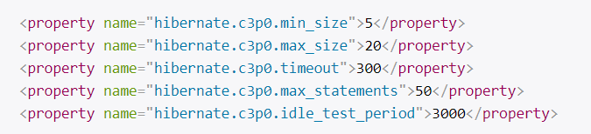
Connection pool
We can set Connection pool in Hibernate Configuration file

Slide 42
Reflection(Java advanced)
Recall we can mark a class, a field or a method.
Q: How hiberate know the class name is “TeachAssistant”?
Reflection provides the following functionalities:
Class
Get class name, class type, annotations based on an object.
Field
Get name, type, annotations based on class.
Get and set value for a field in detail object.
Method <Skip>
Get method name, annotations, required parameters
invoke method with several parameters

Slide 43
Reflection Demo
Demo

Slide 44

Annotation(Java advanced)
Recall we can mark a class, a field or a method. If we try to mark entity for a field:
Now we can get annotations based on reflection
Q: How to implement an annotation, how do I know the @Entity is only for a java class?
Answer: Annotation

Slide 45
Annotation(Java advanced)
Meta - annotation:
Meta - annotation:
Target
Type: Only allow programmer mark this annotation on a class.
Method: Only allow programmer mark this annotation on a method.
Field: Only allow programmer mark this annotation on a field.
Retention
Runtime: visible when JVM running.
Source: Only visible on source file.
Class: Only visible when compiling.
Documented <Skip>
Inherited <Skip>

Slide 46
Annotations Demo
Demo

Slide 47
Simple Hibernate Implementation

Slide 48
Configuration
Hibernate Configuration Object:
Responsibilities:
load configuration from XML or .properties
load url, username, password to access database
show-sql
set auto-ddl
set connection pool
Simple Implementation:
Hard code the url, name, password in configuration object.

Slide 49
SessionFactory
Factory design pattern:
Create different object but have same interface based on configuration.
https://en.wikipedia.org/wiki/Factory_method_pattern
Hibernate Session Factory:
Responsibilities:
load different session implemetation for different database
Because different database have different grammar and dialect.
Maintain connection pool.
Simple Implementation:
I only implement MySQLSessionFactory with very simple code.

Slide 50
Session
Hibernate Session:
Responsibilities:
Support insert/update/delete
session.save(object);
session.delete(object);
Support sql query and hql query
SQLQuery q = session.createSQLQuery(sql).addEntity(object.class);
Query q = session.createQuery(hql);
Simple Implementation:
Support insert/update/delete
session.save(object);
session.delete(object);

Slide 51
Annotation and Data mapping
Hibernate version is more complicated
<Skip>
Simple Implementation:
Technique used: reflection, annotation
Support read annotations
@Entity
@Id
@Column
Support map the data in java to the data in database.
Get and inject data to an object use java reflection

Slide 52
Simple hibernate Demo
Demo

Slide 53
Thanks!

Slide 54
Simple hibernate Demo
Demo

